Slide 1

LINEAR CONTROL
SYSTEMS
Ali Karimpour
Assistant Professor
Ferdowsi University of Mashhad
Notes:
<<<1.1>>>
###Control System Design###
{{{Control, Design}}}

Slide 2
Lecture 2
Modeling of Control Systems
Topics to be covered include:
An industrial example
Modeling of systems
Systems with time delay.

Slide 3
Example 1: An industrial plant
مثال 1: يک سيستم صنعتی
The example, taken from the steel industry, is of a particular nature, however the principal elements of specifying a desired behaviour, modeling and the necessity for trade-off decisions are generic.

Slide 4
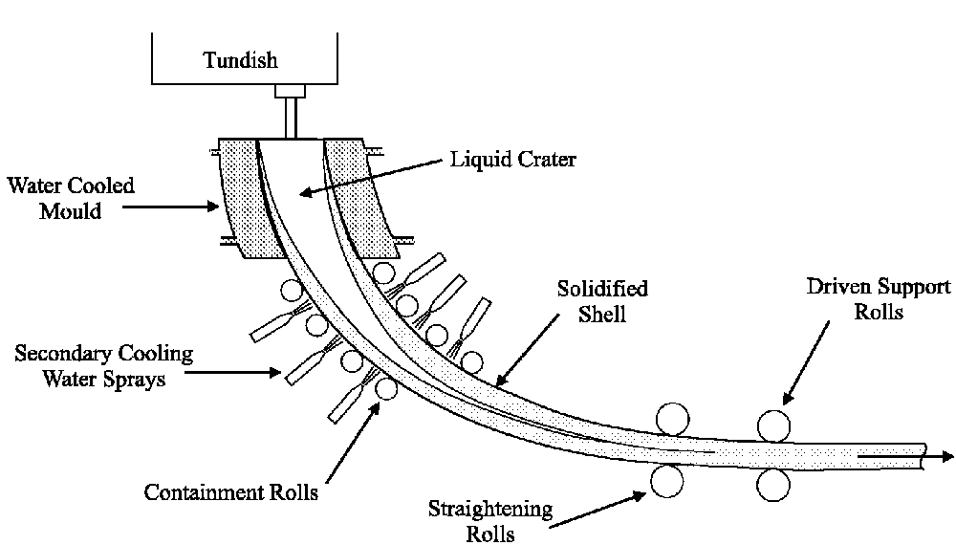
Process schematic of a steel industry نمای شماتيک صنعت فولاد
قيف
دهانه مايع
مايع خنک کننده
پوسته جامد
نورد
مايع خنک کننده ثانويه
نورد نگهدارنده

Slide 5
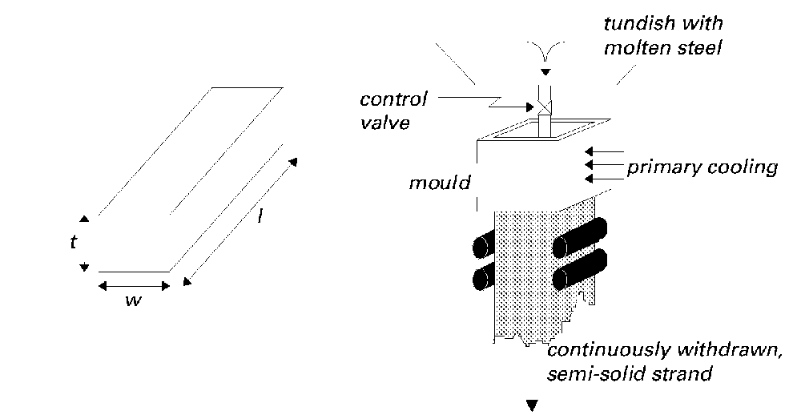
Process schematic of a steel industry (continue)
قيف حاوی مواد مذاب
شير کنترل
قالب گيری
خنک سازی اوليه
يک نمونه شمش

Slide 6
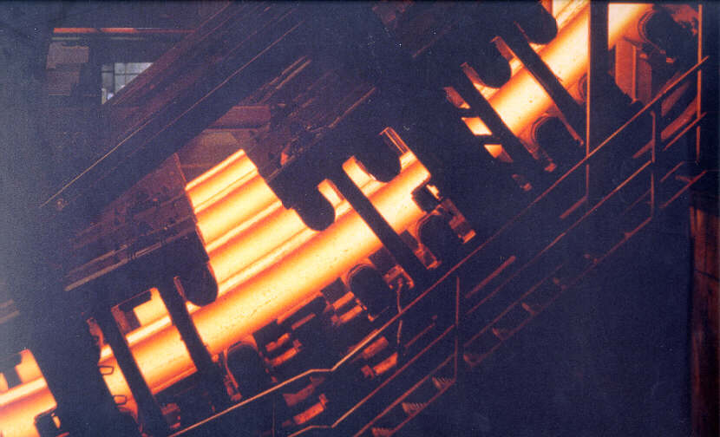
The cast strip in the secondary cooling chamber
نوار ريخته گری در دومين بخش خنک سازی

Slide 7
Performance specifications
مشخصه های عملکردی
The key performance goals for this problem are:
Safety: Clearly, the mould level must never be in danger of overflowing or emptying as either case would result in molten metal spilling with disastrous consequences.
Profitability: Aspects which contribute to this requirement include:
  Product quality
  Maintenance
  Throughput

Slide 8
Definition of the control problem
Abstracting from the above particular problem, we can introduce:
Definition 2.1:
The central problem in control is to find a technically feasible way to act on a given process so that the process behaves, as closely as possible, to some desired behaviour. Furthermore, this approximate behaviour should be achieved in the face of uncertainty of the process and in the presence of uncontrollable external disturbances acting on the process.
Notes:
<<<2.4>>>

Slide 9
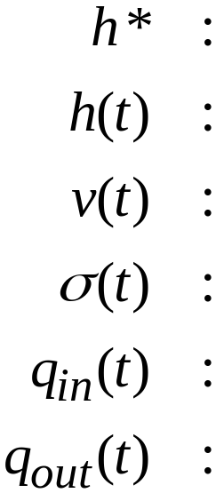
Modeling
مدلسازی
commanded level of steel in mould
actual level of steel in mould
valve position
casting speed
inflow of matter into the mould
outflow of matter from the mould

Slide 10
Modelling a simple tank
مدلسازی يک منبع ساده
Tundish
قيف
Molten Steel
Valve
شير
Mould Level
آب خنک کننده
سطح قالب گيری
Cooling Water

Slide 11
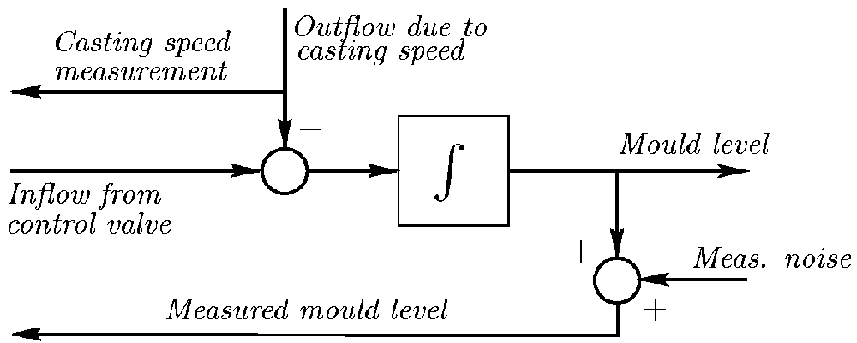
Simplified block diagram for modeling
بلوک دياگرام ساده شده برای مدلسازی
Block diagram of the simplified mould level dynamics,
sensors and actuators
خروجی با توجه به سرعت
ريخته گری
سطح قالب گيری
ورودی با توجه به شير کنترل
نويز اندازه گيری
سطح قالب گيری اندازه گيری شده

Slide 12
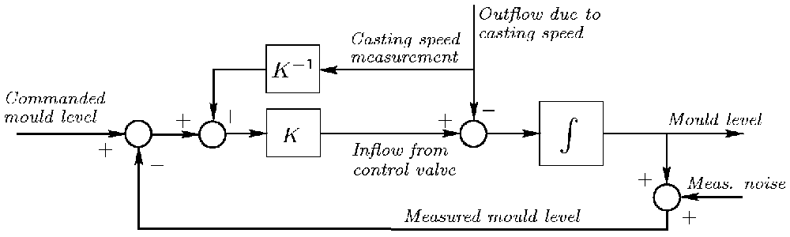
Suggested Control Strategy
استراتژی پيشنهادی برای کنترل

Slide 13
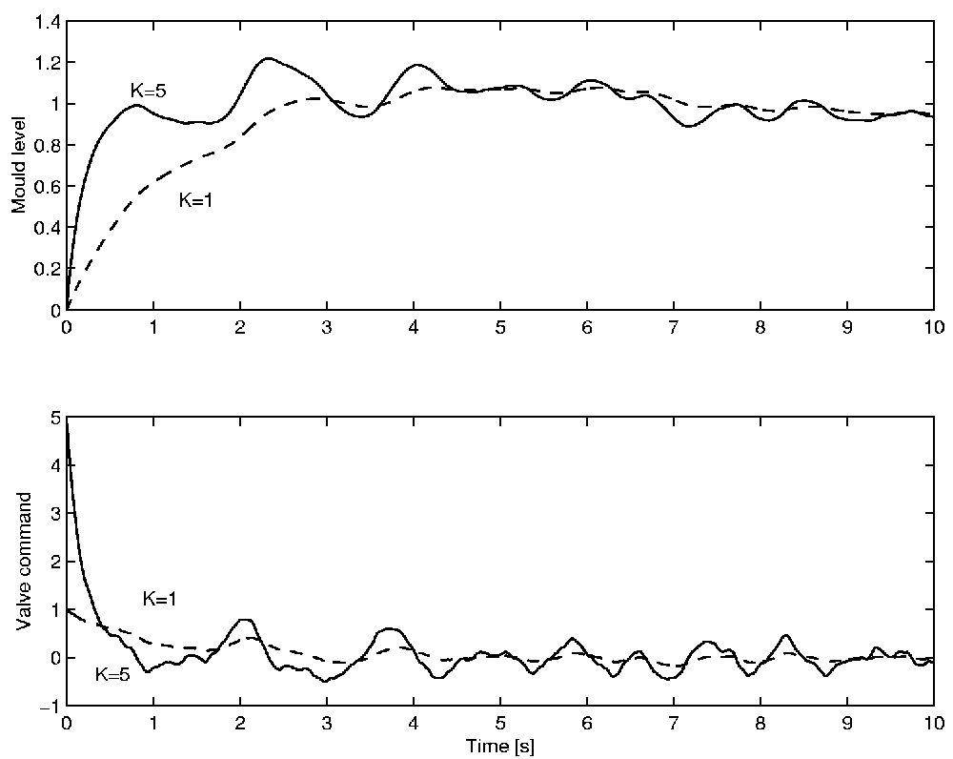
Result of simulation shows a trade off
نتايج شبيه سازی نياز به مصالحه با توجه به

Slide 14
Level of compromise
سطح مصالحه
We may ask if these trade-offs are unavoidable or whether we could improve on the situation by such measures as:
better modelling
more sophisticated control system design
(Aside: Actually the trade-off is fundamental as we shall see presently).

Slide 15
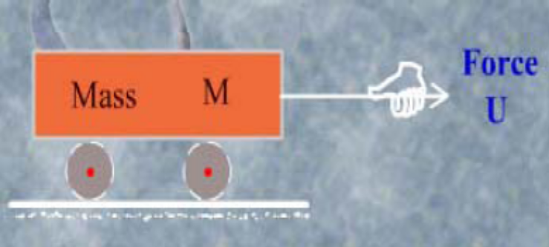
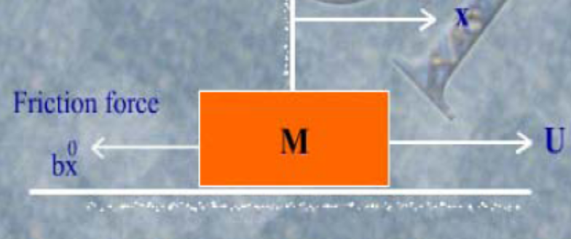

Example 2: Dynamics of a mechanical system
مثال 2: ديناميک يک سيستم مکانيکی
خروجی
ورودی

Slide 16
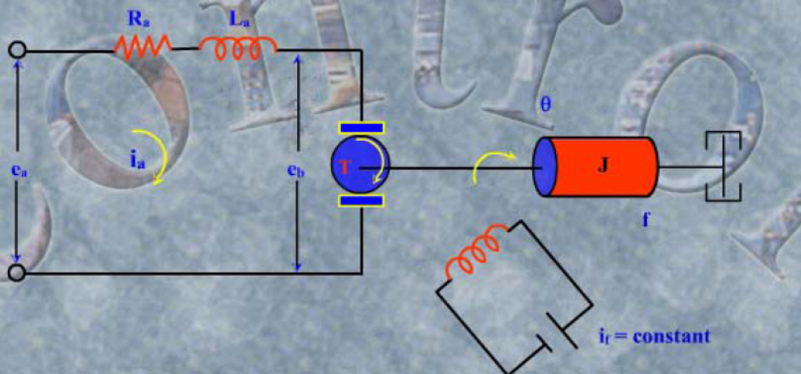
Example 3:Dynamics of a electromechanical system
مثال 3: ديناميک يک سيستم الکترومکانيکی

Slide 17
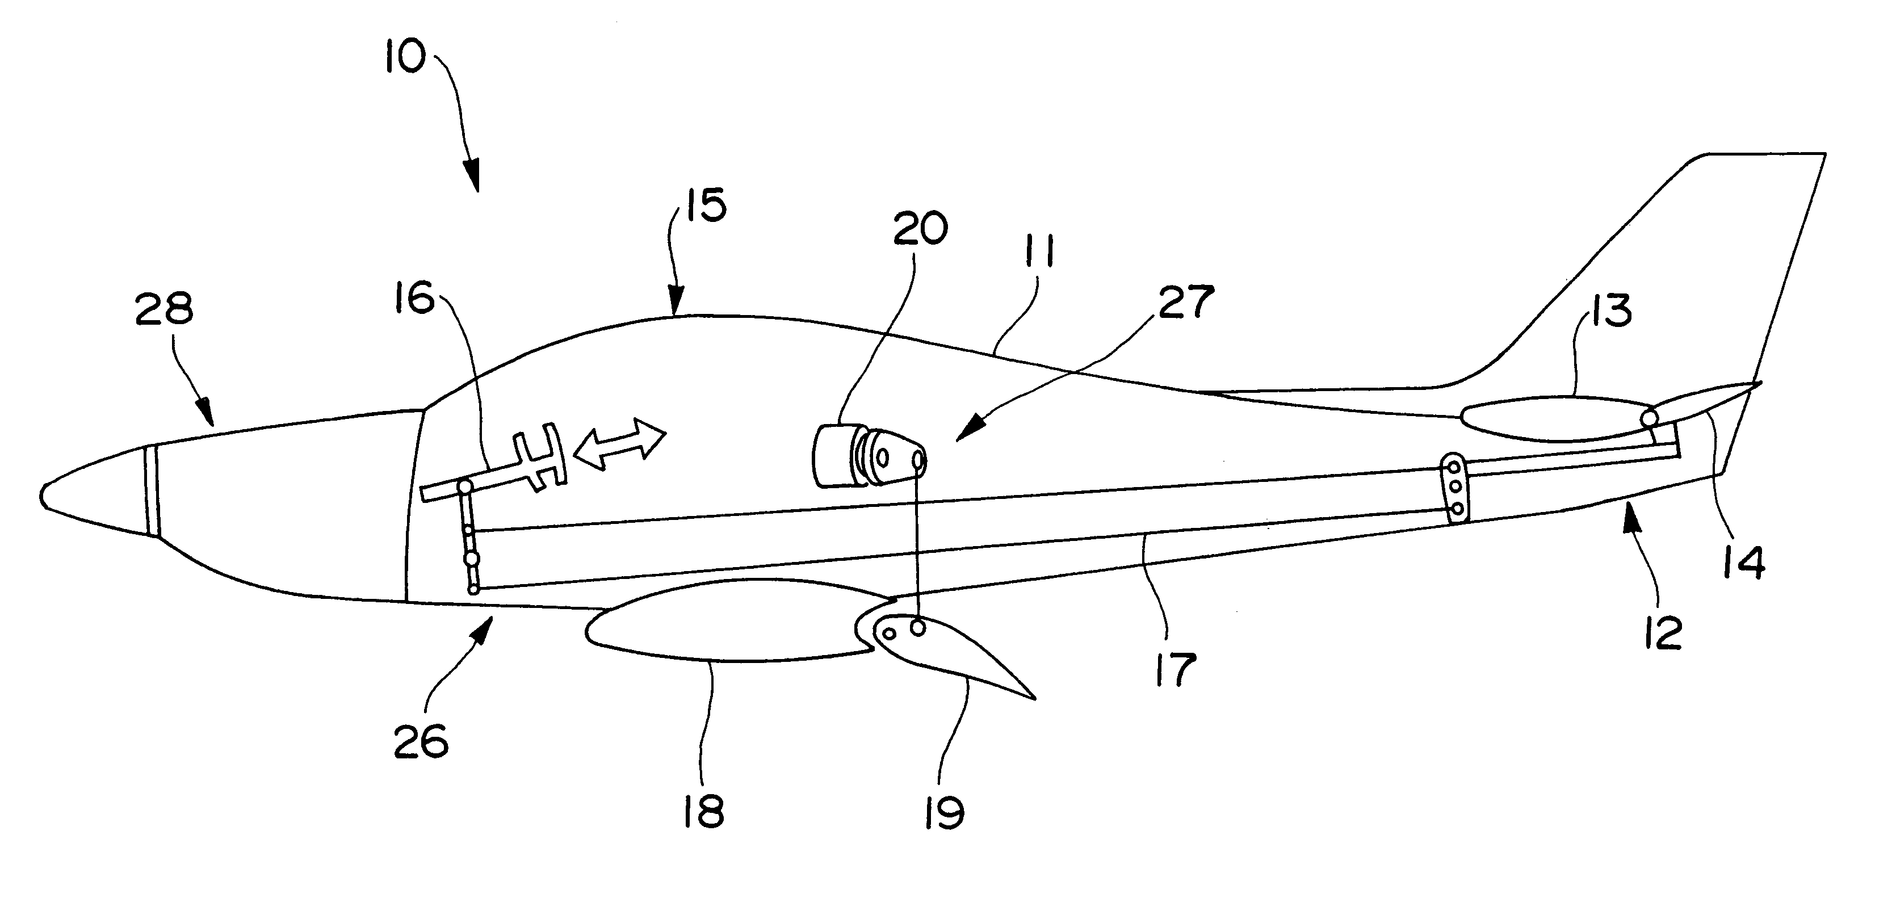
A simplified aeroplane
يک هواپيمای ساده شده

Slide 18
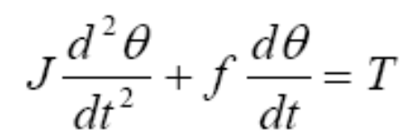
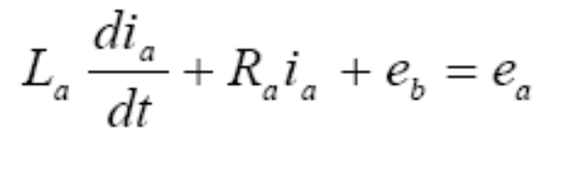
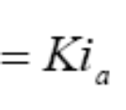

Example 3: Continue
مثال 3: ادامه
خروجی
ورودی
e_{b}

Slide 19
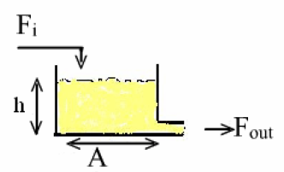
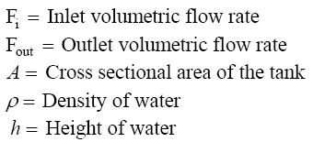
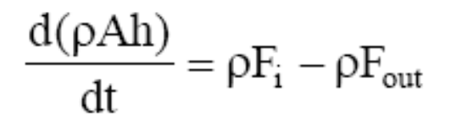
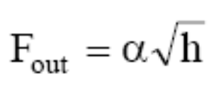
Example 4: Dynamics of a liquid level system
مثال 4: ديناميک يک سيستم سطح مايعات
ورودی
خروجی
خروجی

Slide 20
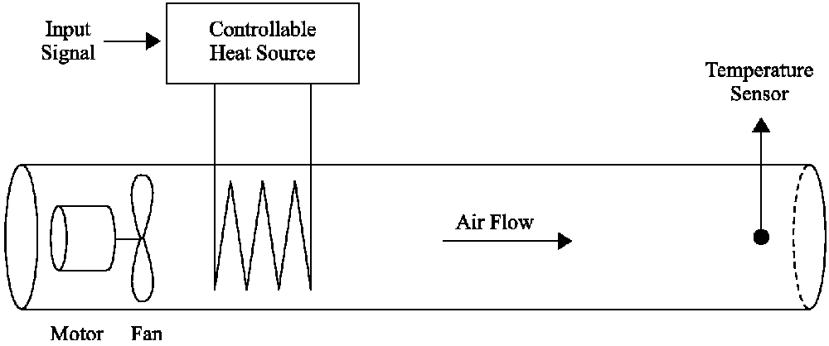
Systems with delay
سيستمهای دارای تاخير
سنسوردما
سيگنال ورودی
جريان هوا

Slide 21
Exercises
تمرين
2-1 Suppose u=sint as input for the system in example 2, find the output of the system.
2-2 Repeat example 3, but neglect the inductance of the motor.
2-3 Repeat example 3, but consider the motor as a series motor.

Slide 22
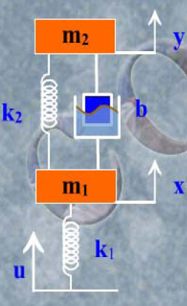

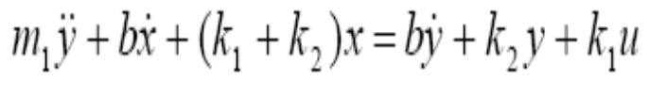
Exercises (Continue)
تمرين ادامه
2-4 Find the mathematical model of the following system.
Final answer is:

